Slide 1
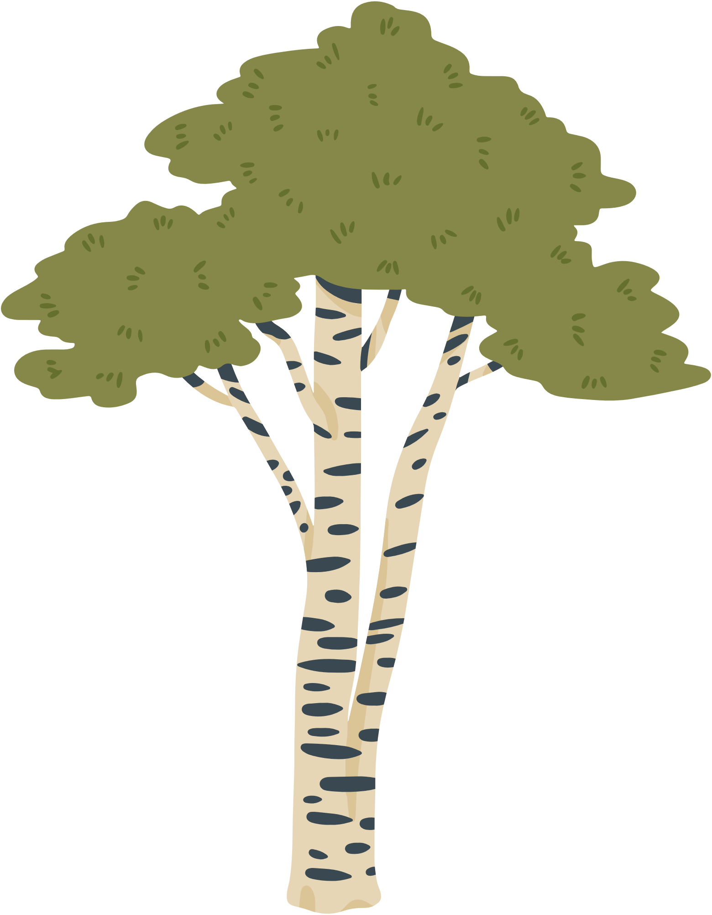

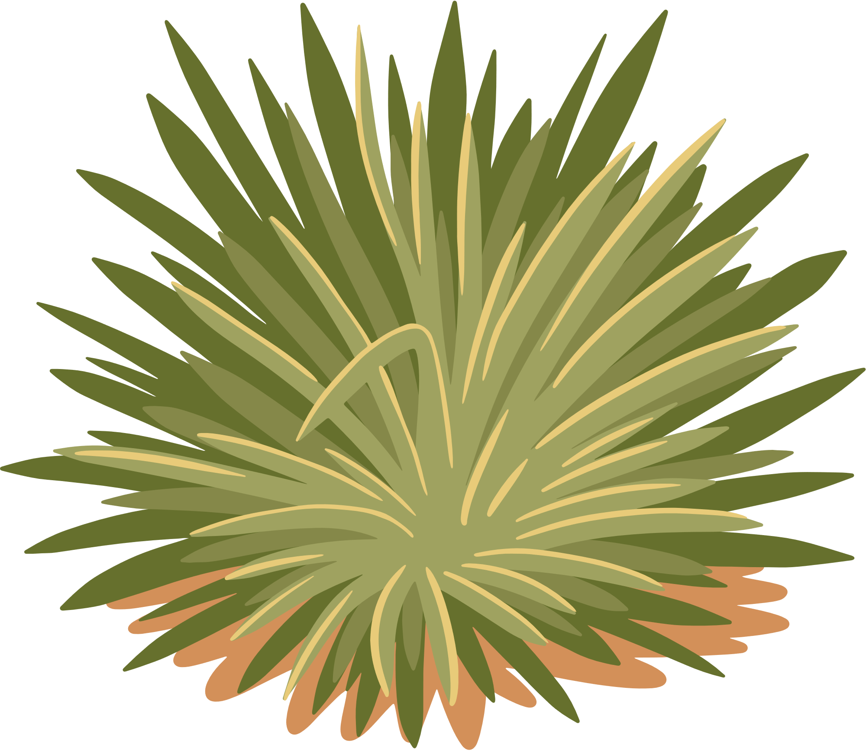
ALL ABOUT
HEATHER
(and some ants)

Slide 2


BSc at Lancaster University
MSc at Natural History Museum & Imperial College London

Slide 3
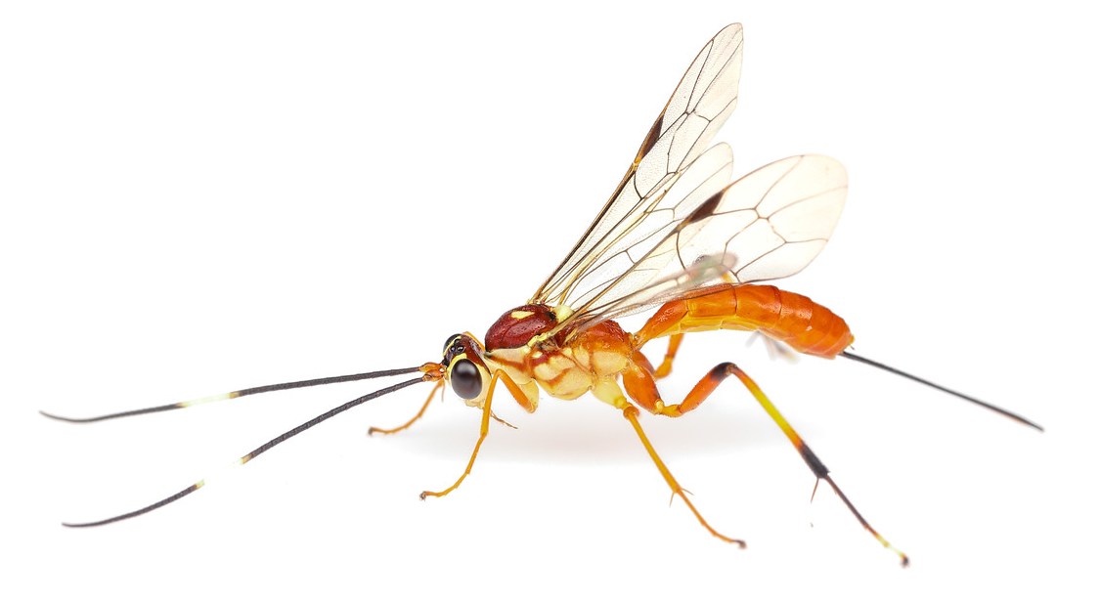
BERGMANN’S RULE IN PARASITOID WASPS

Slide 4

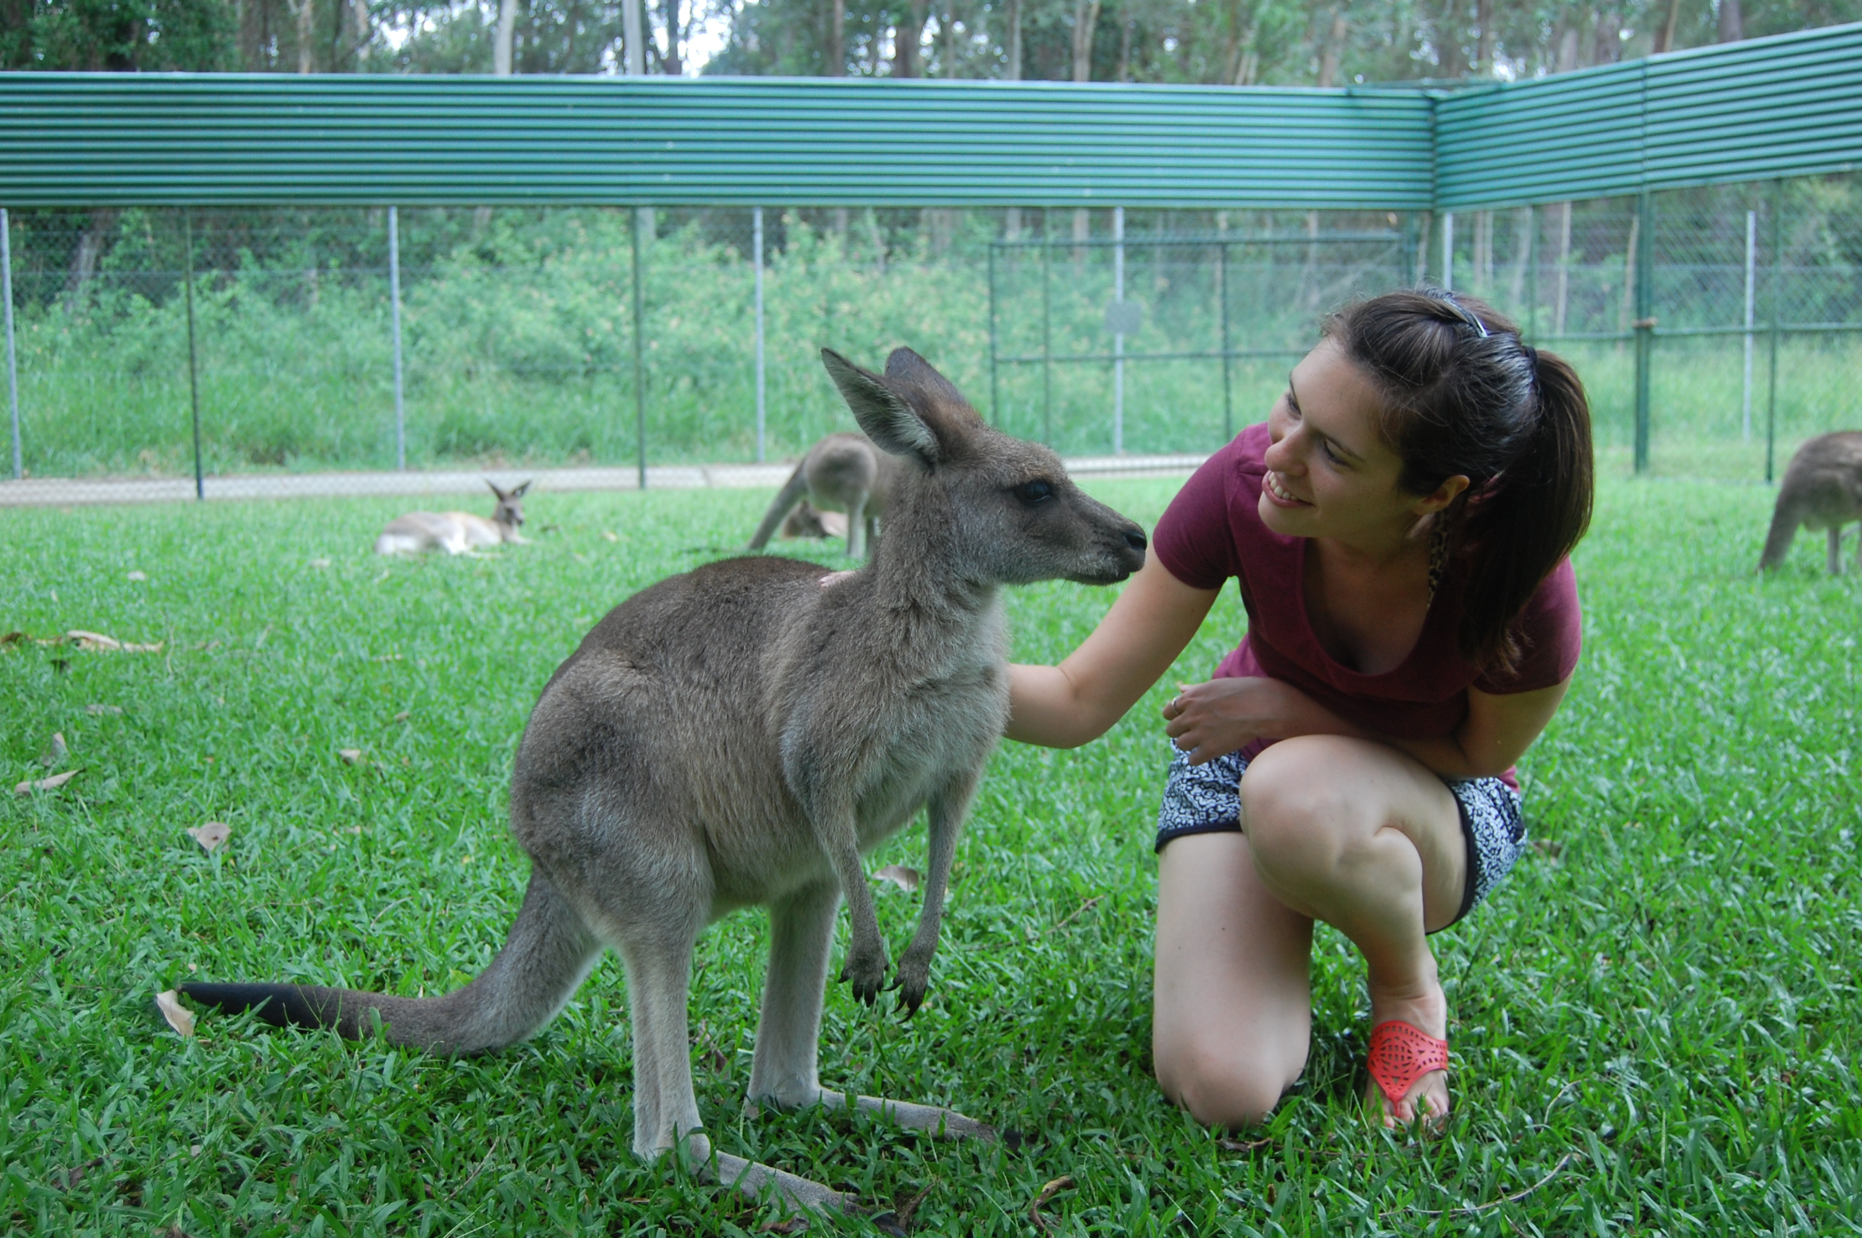
PhD at Reading University
Endeavour Visiting Fellow at Western Sydney University

Slide 5
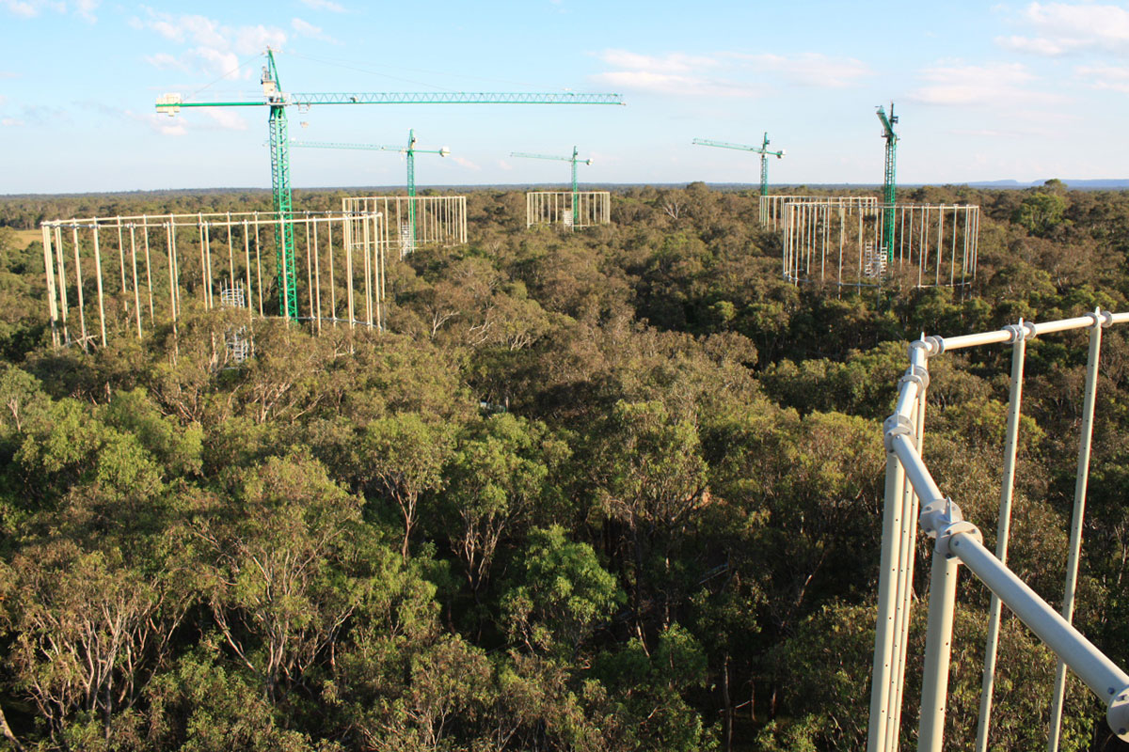
Ant communities in eucalyptus woodland under enriched CO2 regimes

Slide 6
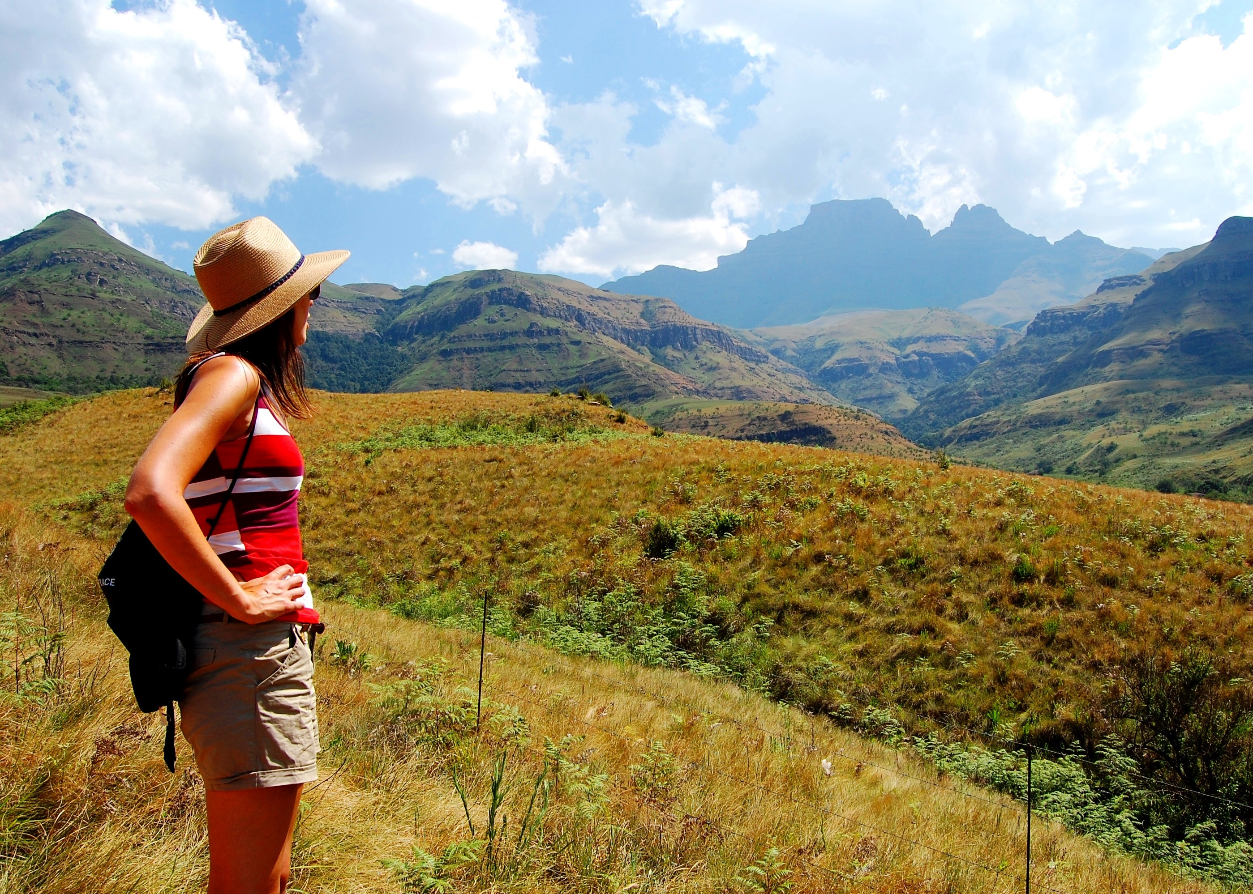
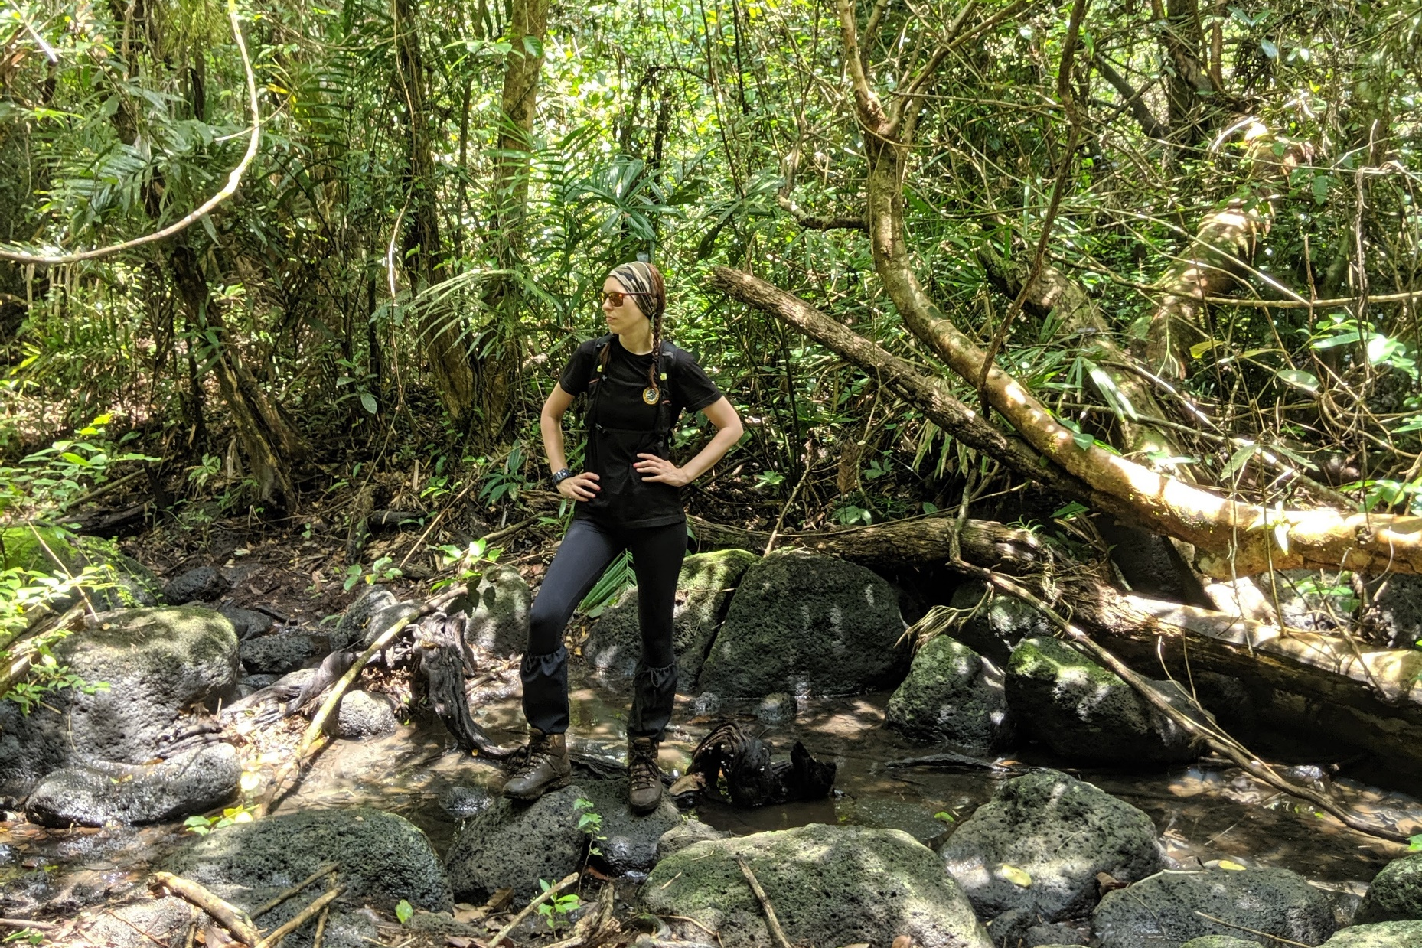
Postdoctoral fellow at University of Pretoria
Senior Lecturer in Entomology at Harper Adams University

Slide 7
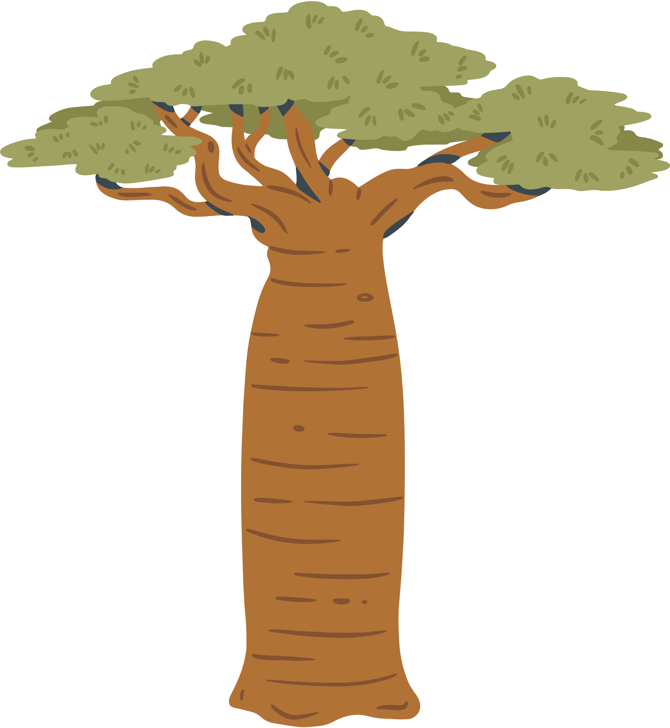










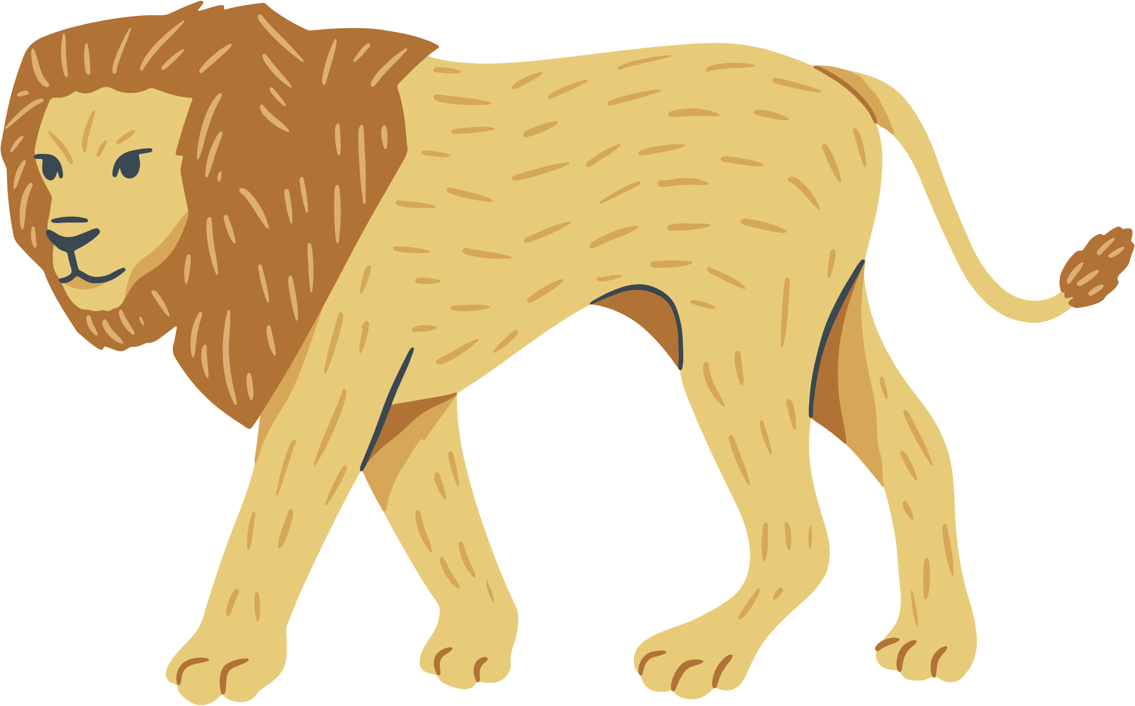
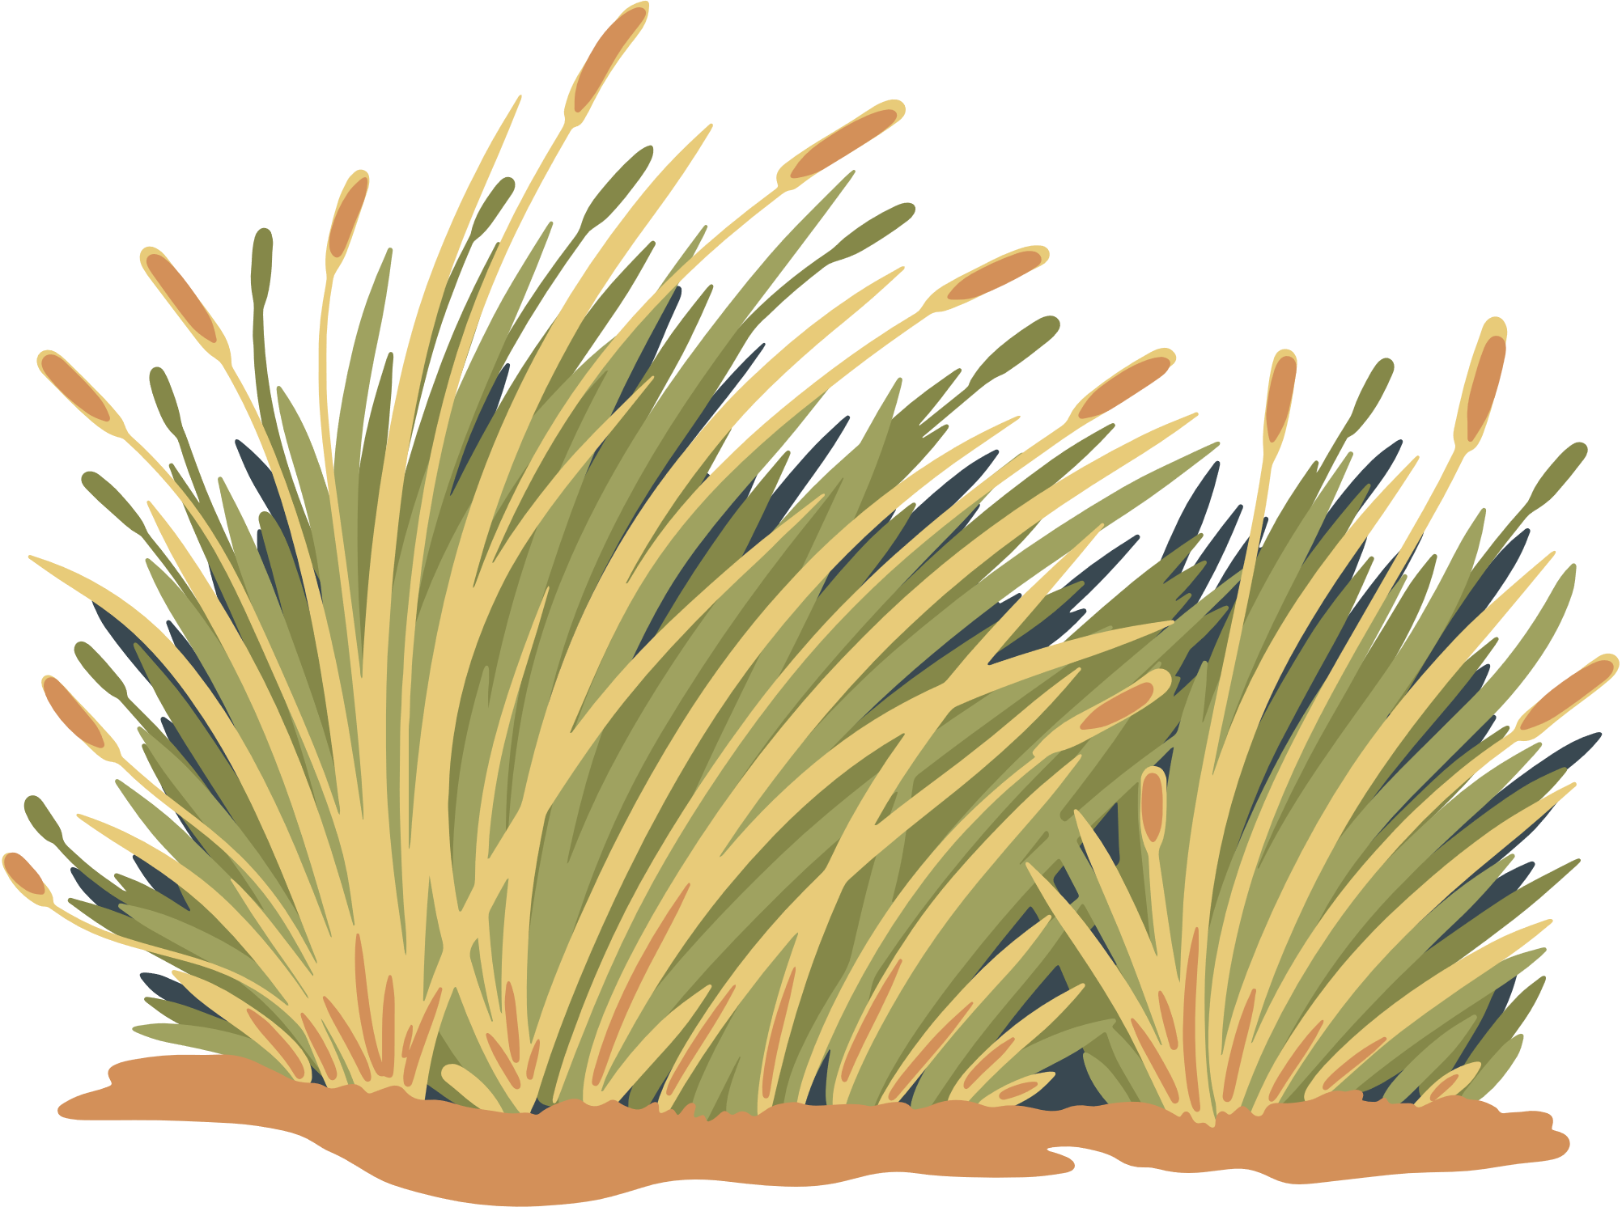
NAME THAT FLAG

Slide 8
NAME THAT FLAG
SPAIN
UGANDA
KENYA
LESOTHO
MOZAMBIQUE
TANZANIA
AUSTRALIA
NAMIBIA
SOUTH AFRICA
VIETNAM

Slide 9
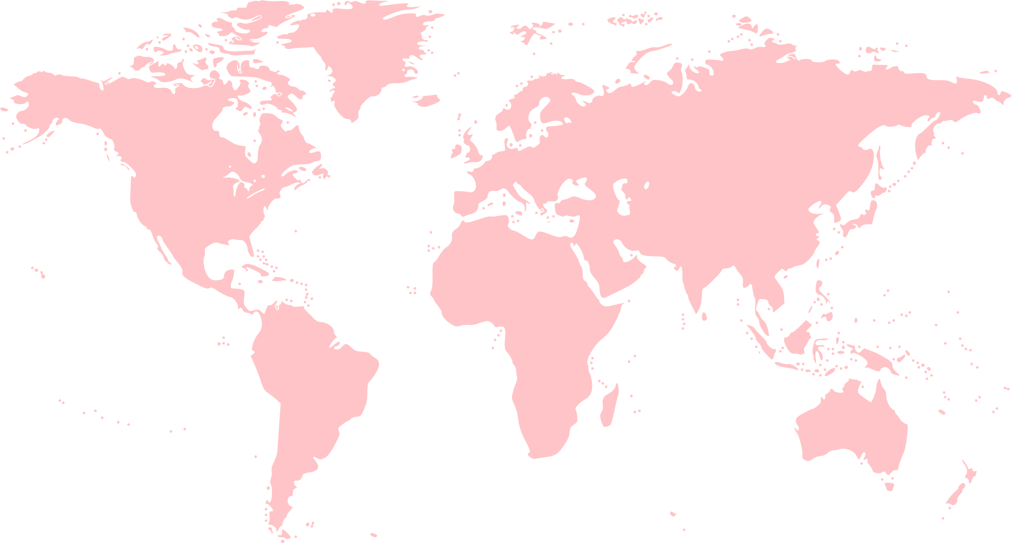


Slide 10

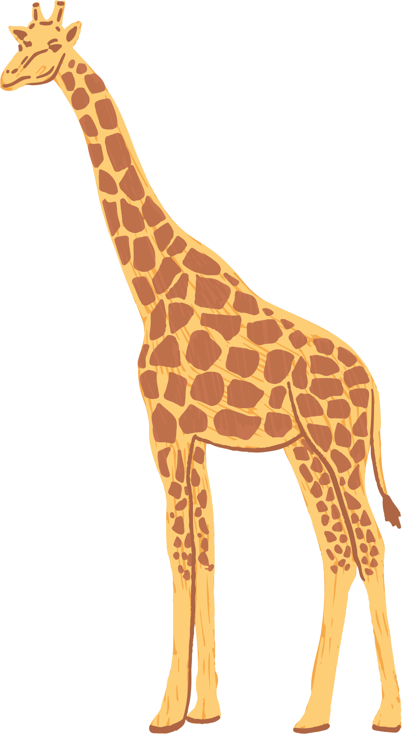
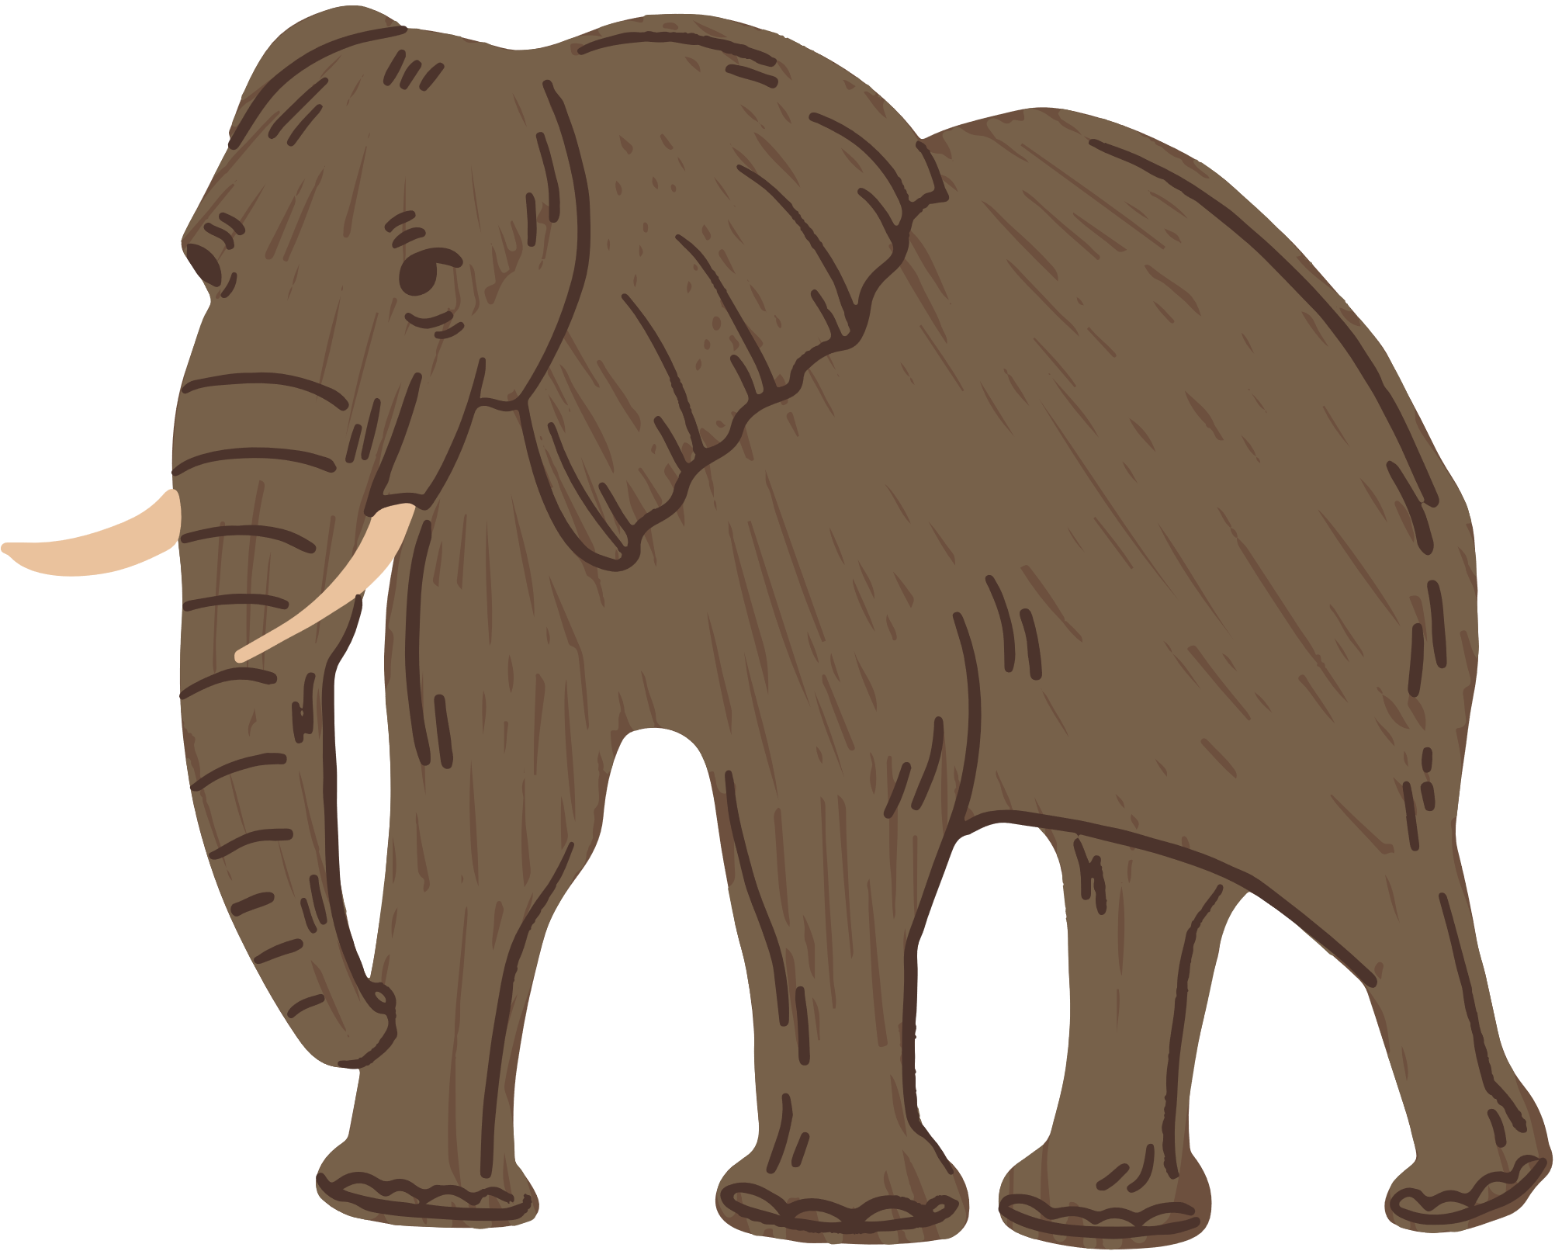
AFRICAN
Ant Ecology
Community ecology
Insect diversity and conservation
Ant-plant mutualisms
Disturbance ecology
Citizen science

Slide 11
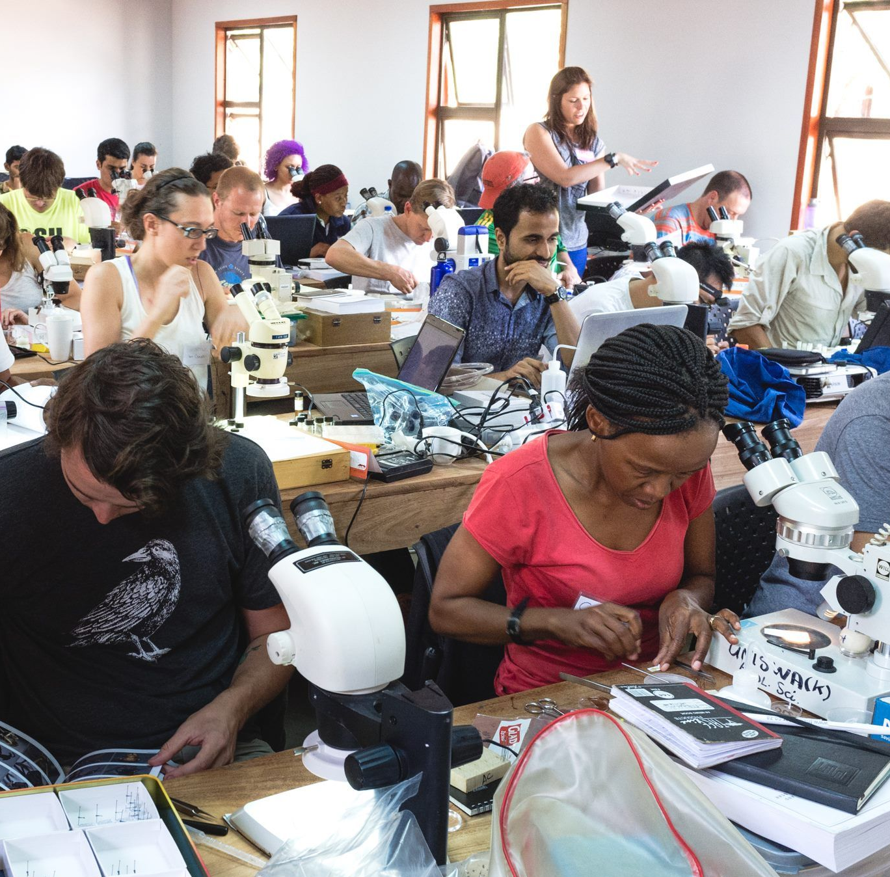

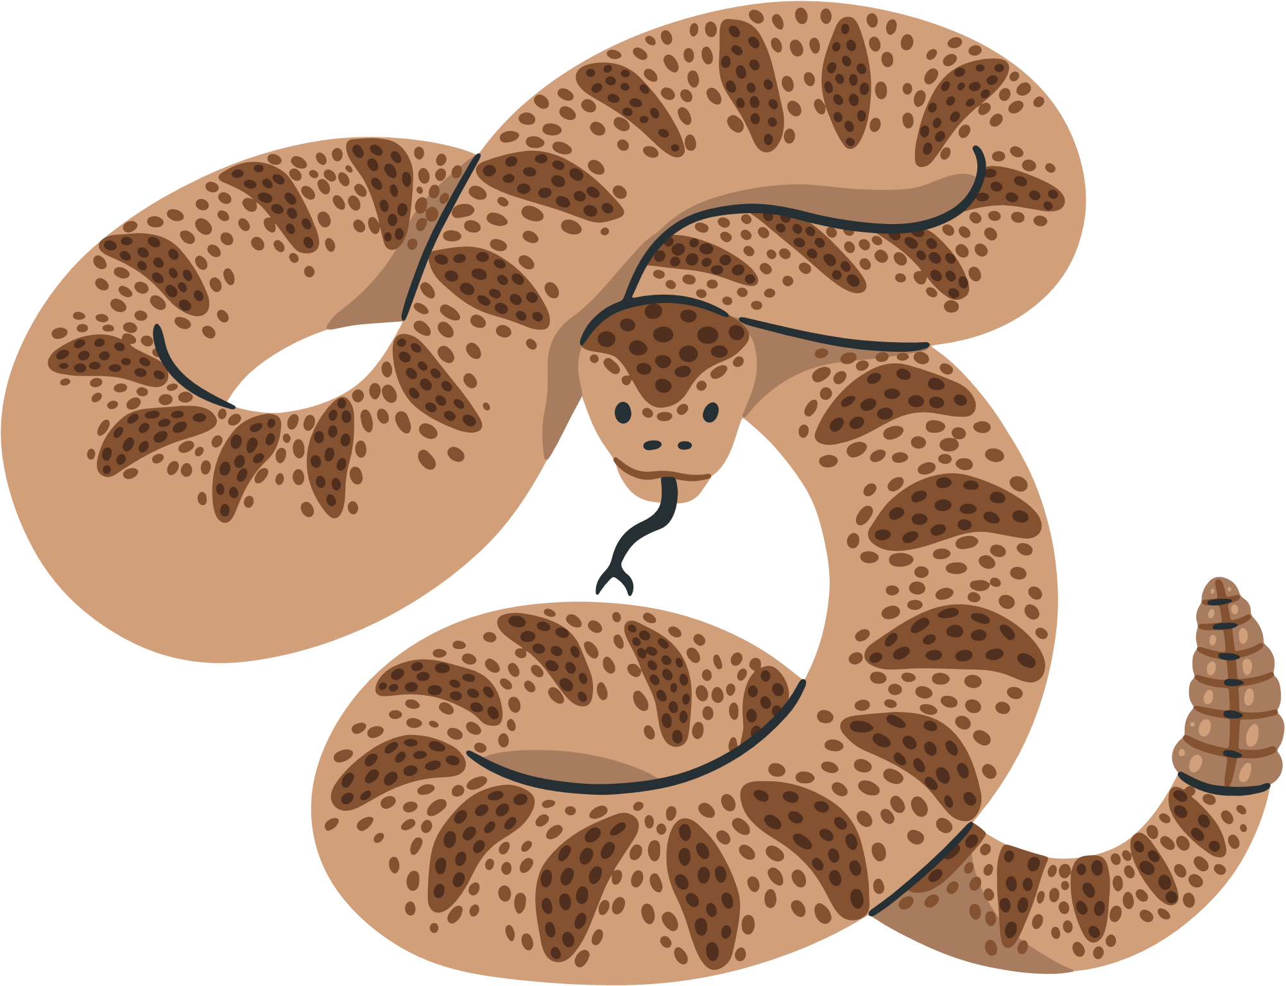
PEDAGOGY OF ENTOMOLOGY

Slide 12
ANT-PLANT MUTUALISMS
Camelthorn acacia, Vachellia erioloba, is most widespread tree in Namibia but under threat from harvesting & land use changes
Hollow swollen-thorn domatia are inhabited by ants
Herbivores range from giraffes to insects, including outbreaks of G. postica silk moths that defoliate entire trees

Slide 13
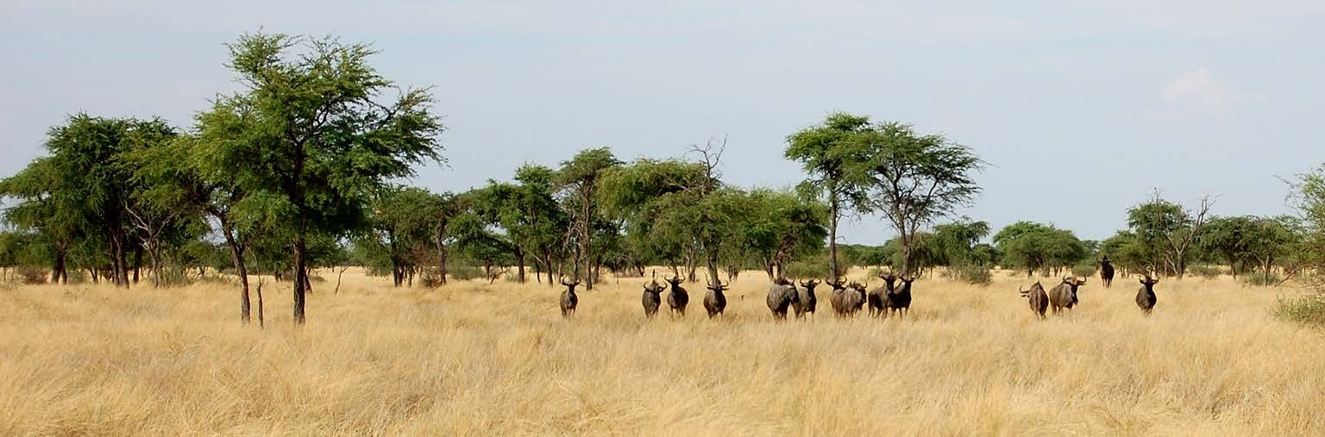
CAMELTHORN ACACIA DOMINATED SAVANNAH

Slide 14
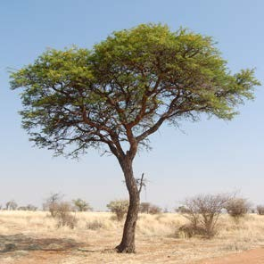
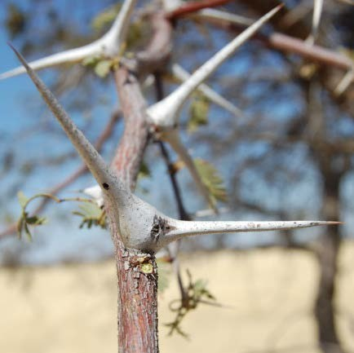
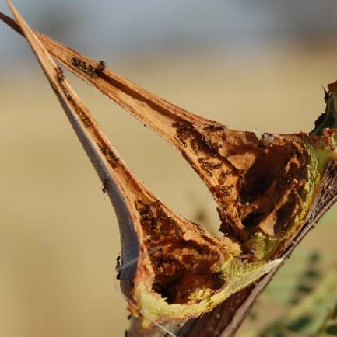
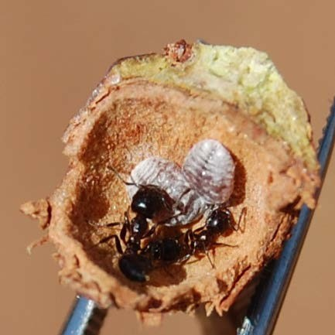
CAMELTHORN ACACIA DOMINATED SAVANNAH

Slide 15
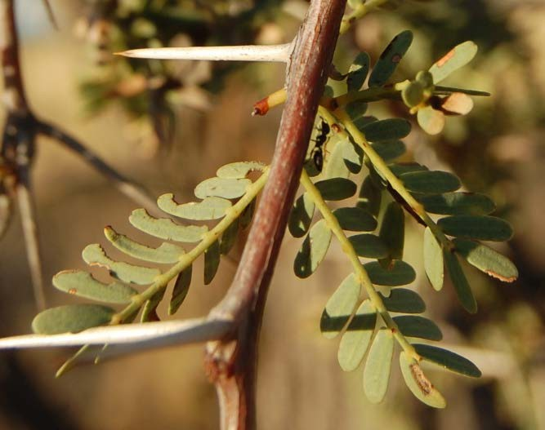
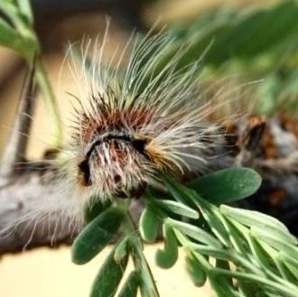
PROVISION OF ANTIHERBIVORE DEFENCE BY ANTS
Herbivore damage was higher on branches without ants. Ants defend against beetles and bugs but not caterpillars.

Slide 16

ANTS IN ARID ECOSYSTEMS
Afrotropics & arid ecosystems are poorly sampled
Namibia has high levels of invertebrate endemism but virtually no work conducted on ants (5 papers since 1986)
Notes:
Namibia is 3 x larger than UK

Slide 17
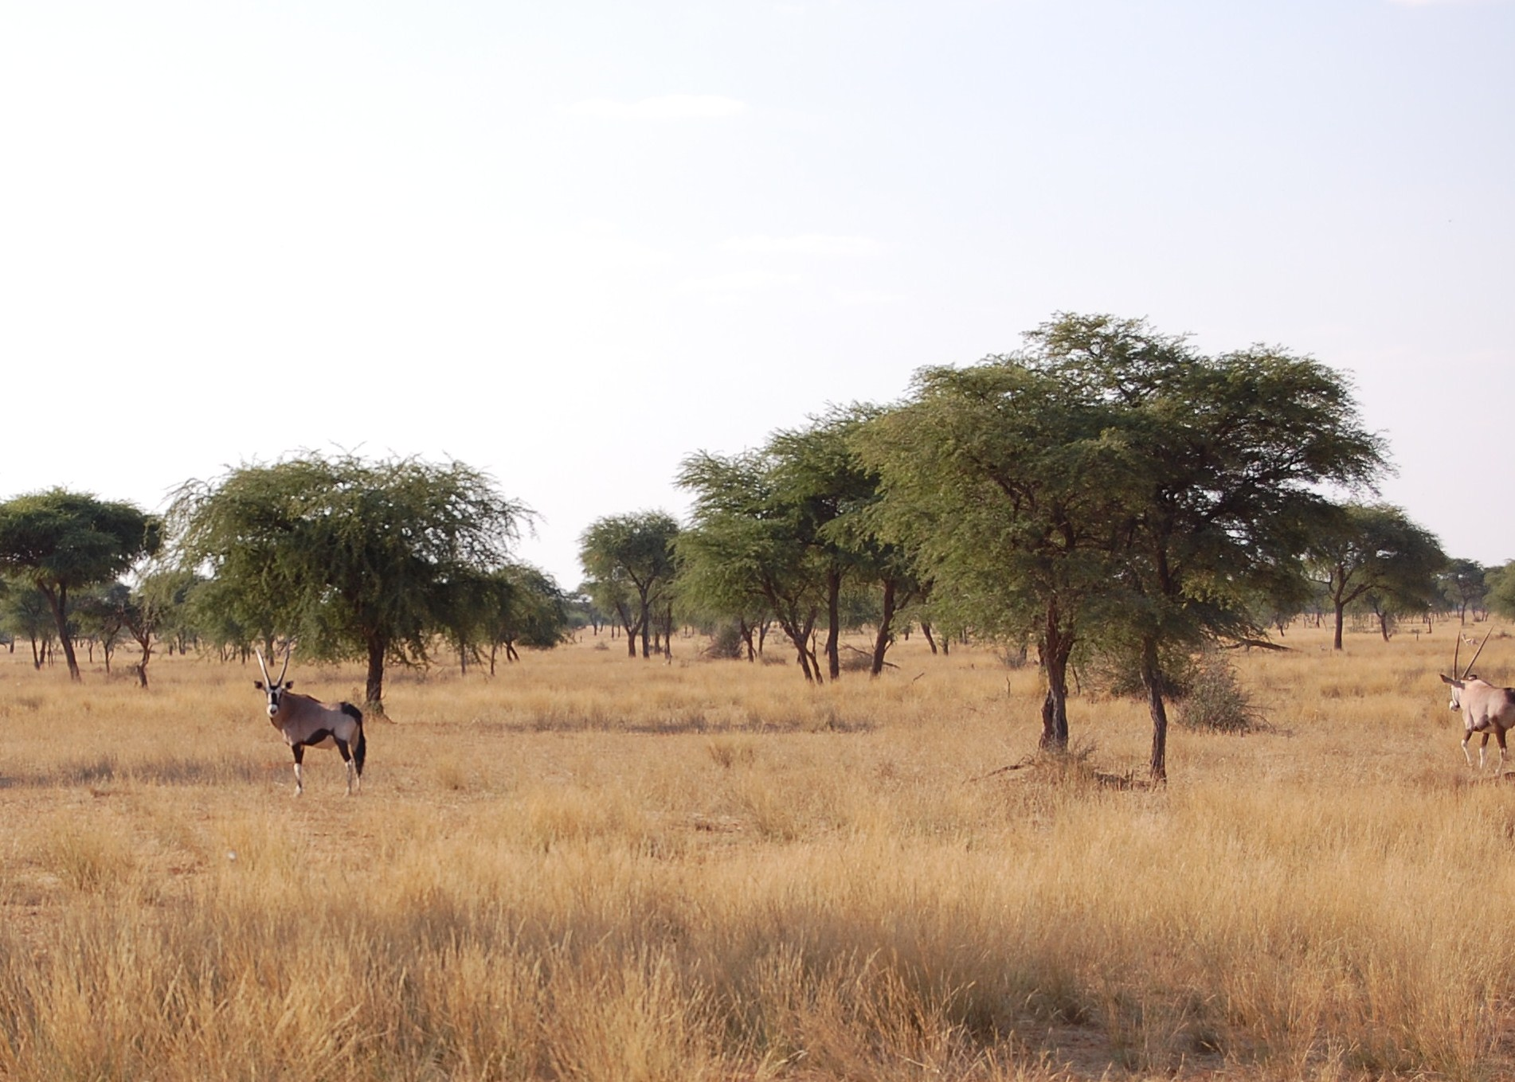
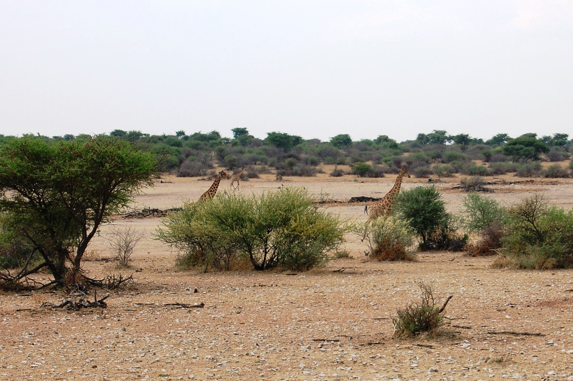
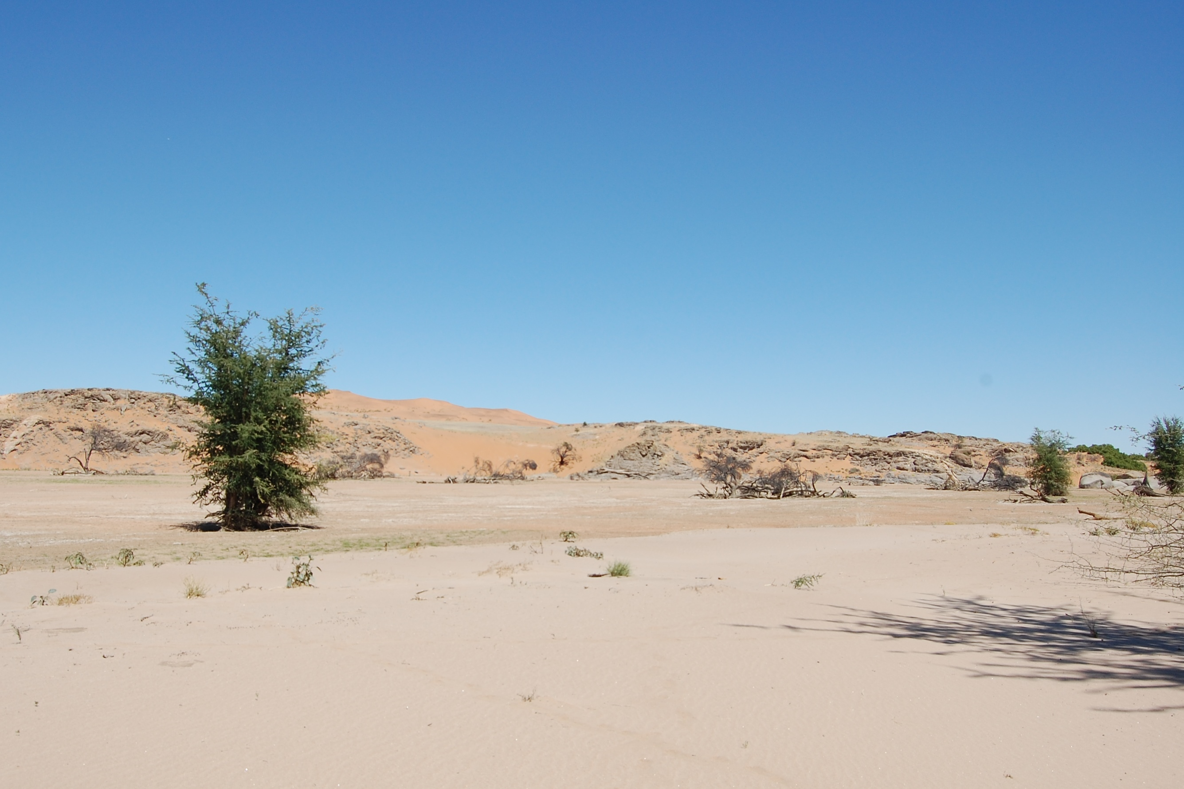
Kalahari savannah
Kalahari saltpan
Namib desert
Notes:
Don’t run from rhinos!
20% habitat is savannah

Slide 18
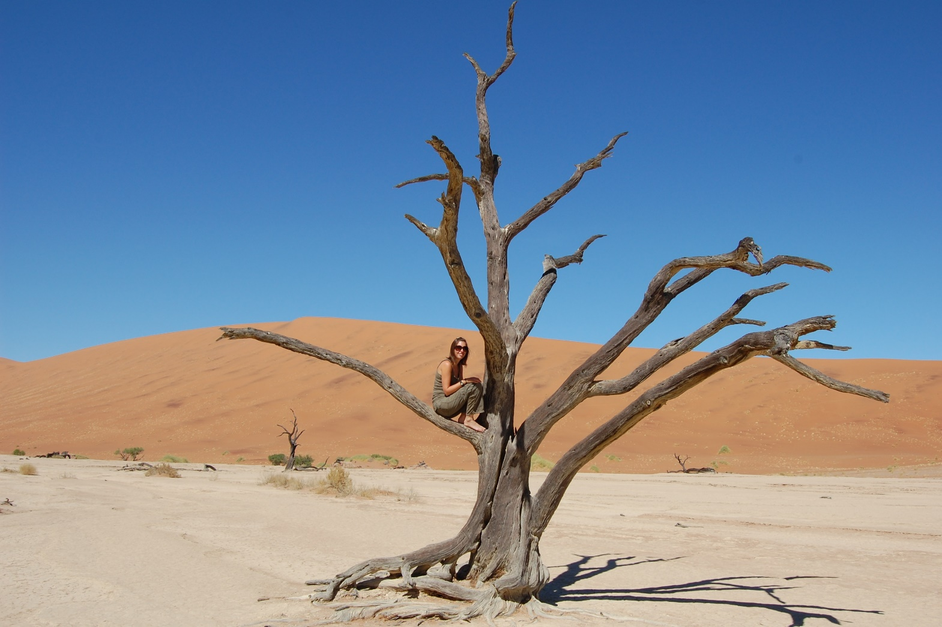
ANTS IN ARID ECOSYSTEMS
Low diversity systems
Overall diversity differs between habitats & strata
Composition of assemblages driven by vegetation & climate
Competition is more important in ground than arboreal assemblages
Vegetation strongly influences ant assemblage dynamics

Slide 19
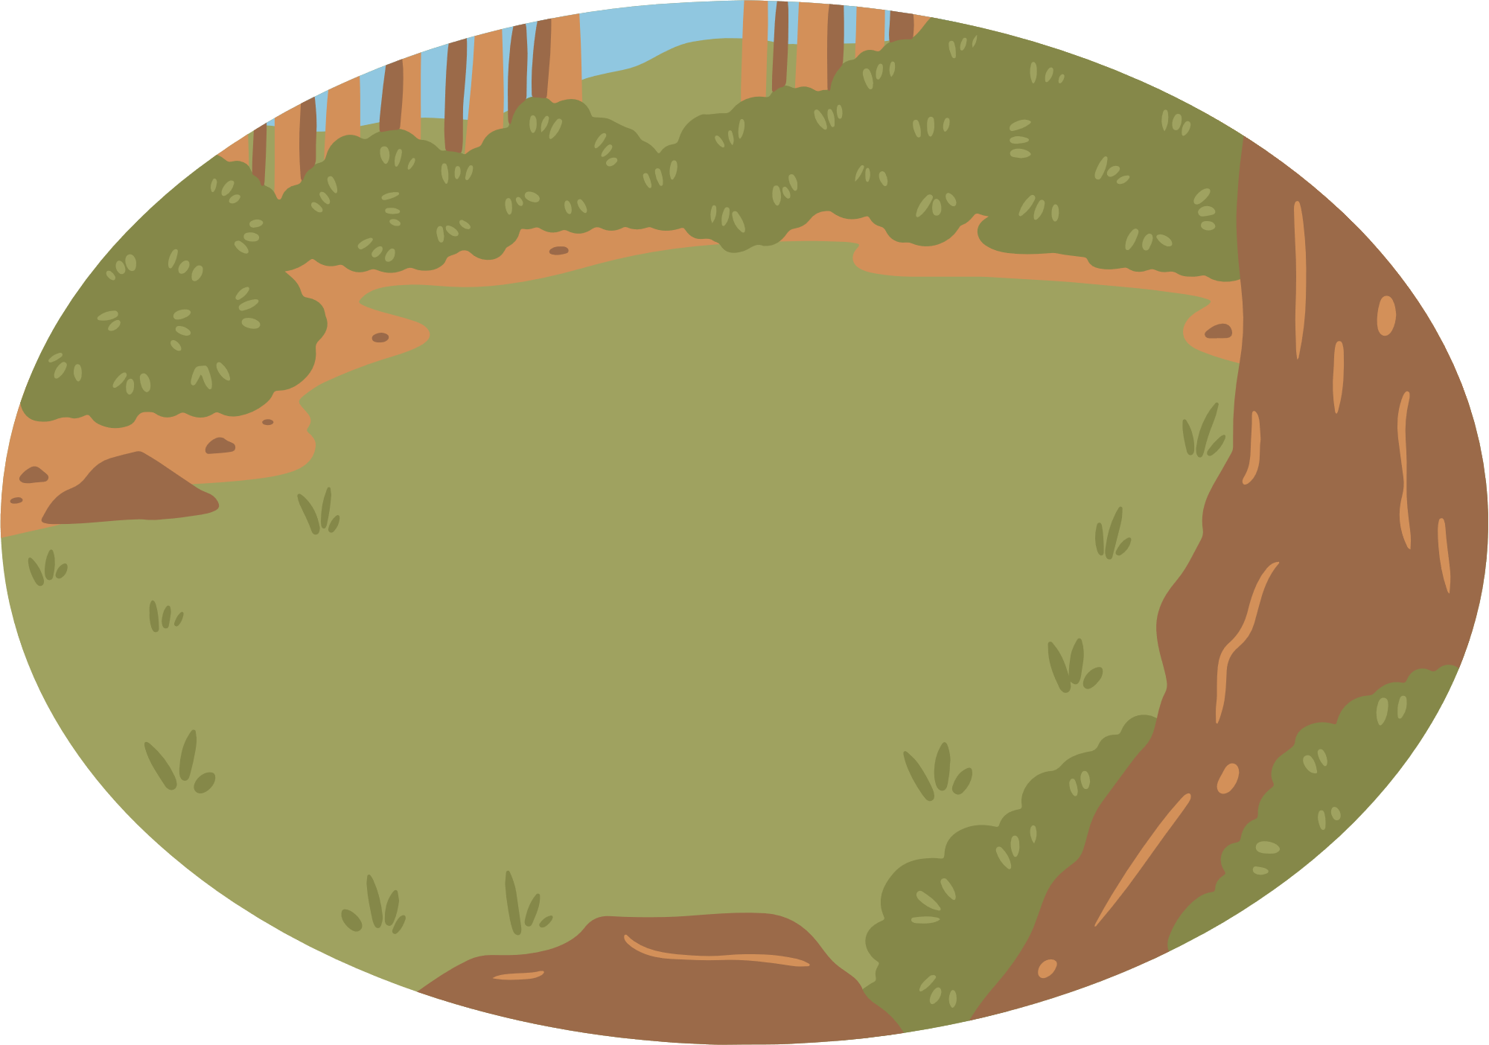
ANTS & HABITAT DISTURBANCE
Maputaland Sand Forest is a unique vegetation type in South Africa/Mozambique
High levels of plant and animal endemism
Highly impacted by elephant activity

Slide 20
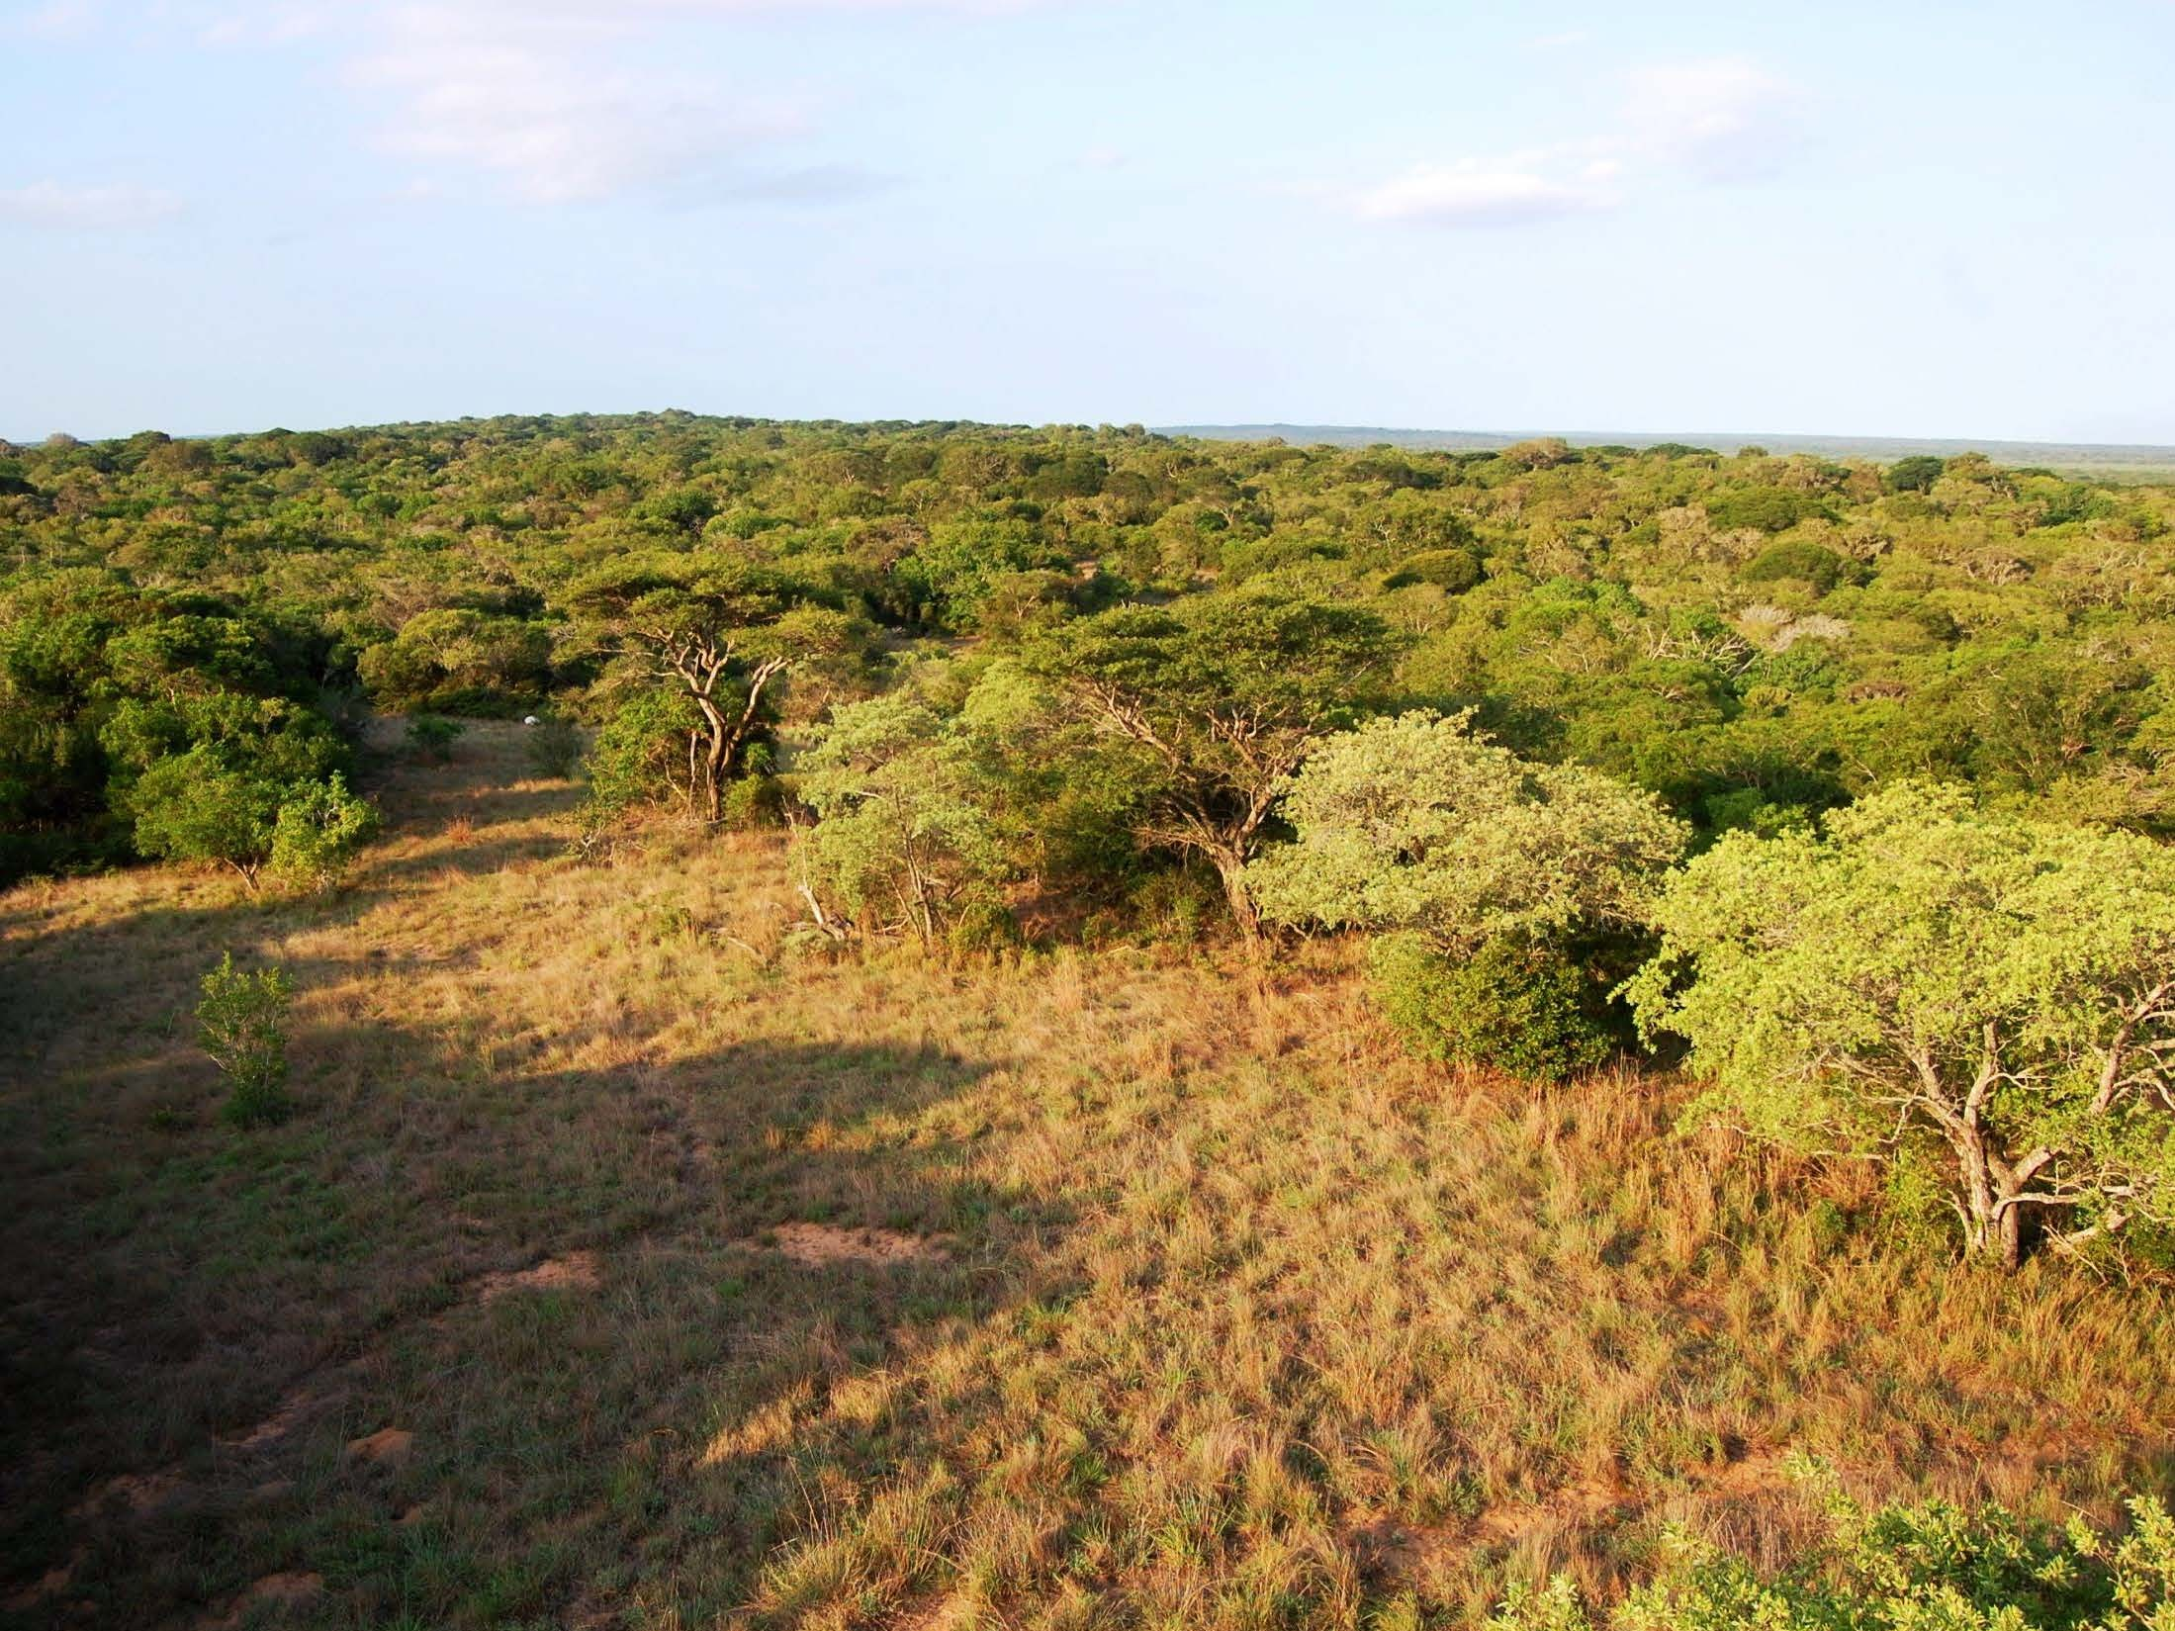
SAND FOREST
OPEN MIXED WOODLAND

Slide 21
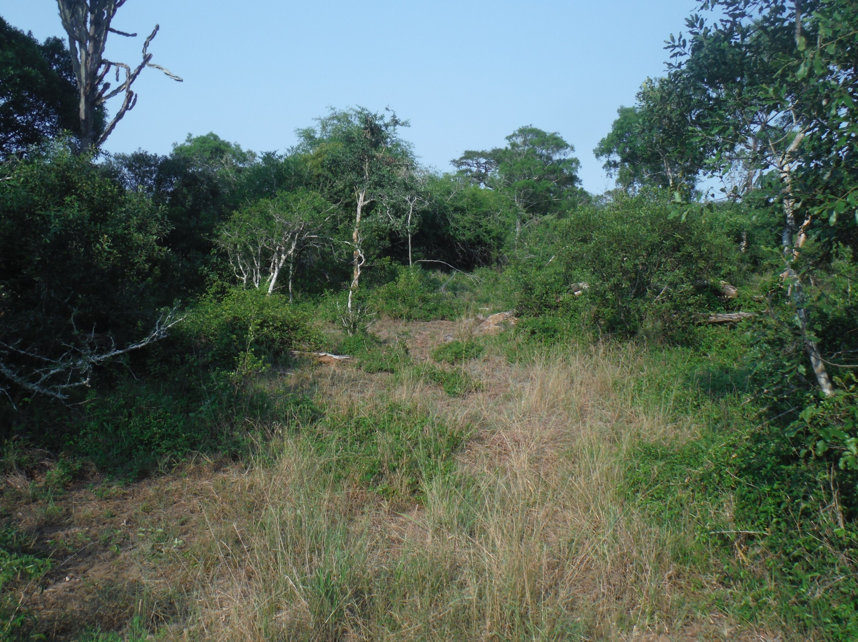
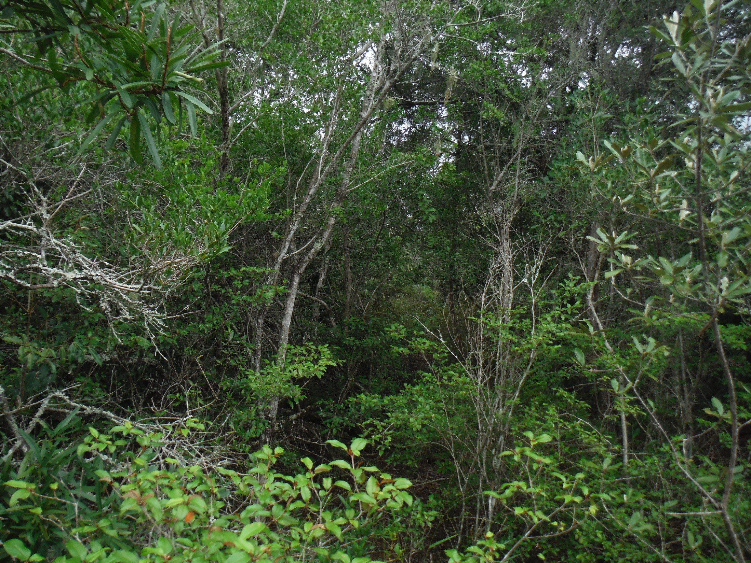
ELEPHANT DISTURBED SAND FOREST (OPEN)
UNDISTURBED SAND FOREST (CLOSED)

Slide 22
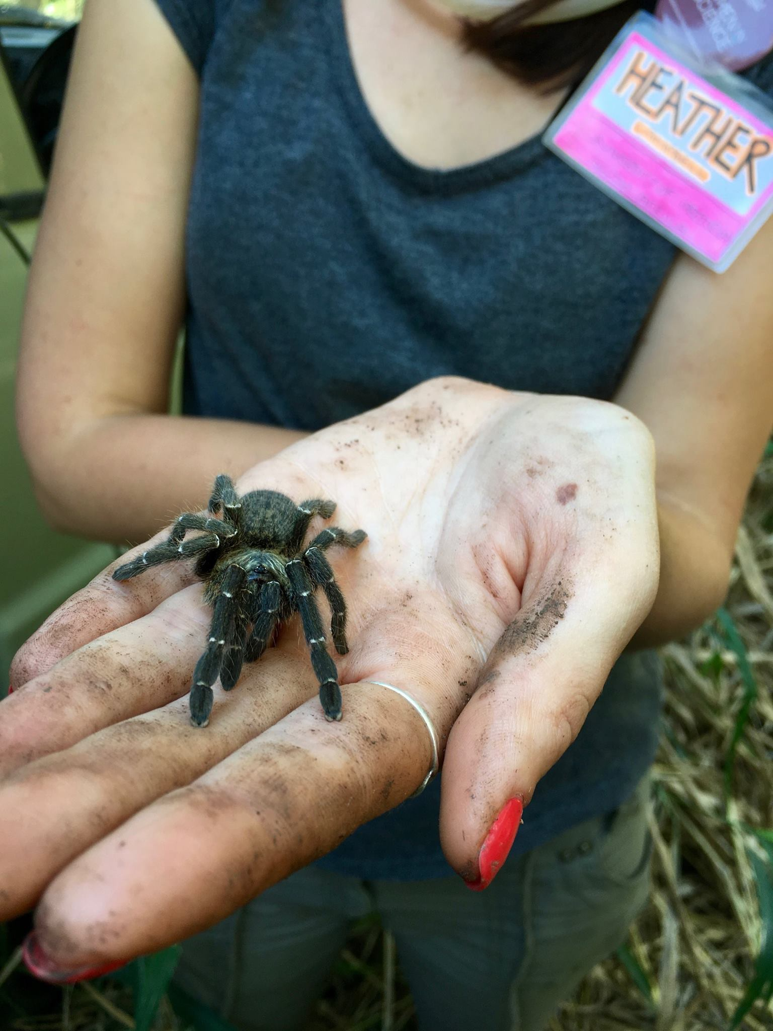
CITIZEN SCIENCE
Baboon Spider Atlas
FEAR
BABOON SPIDER ATLAS
PHOTO
GRAPH
SOCIAL MEDIA POST

Slide 23

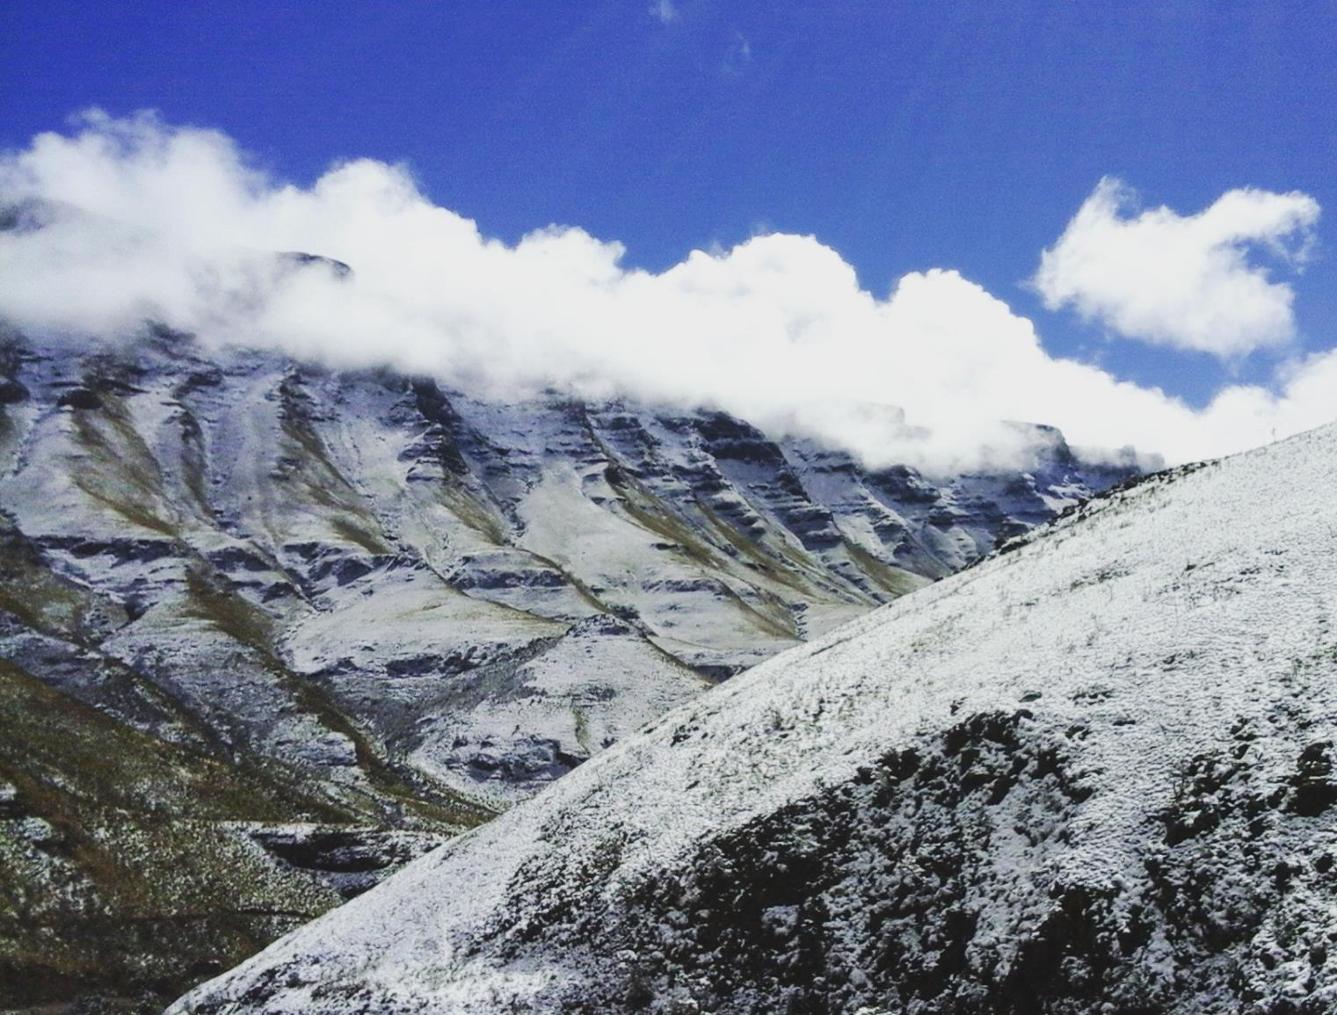
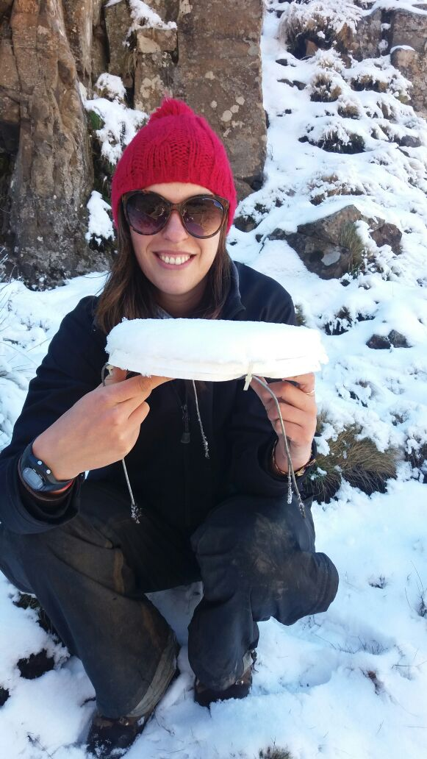
ANTS & ELEVATIONAL GRADIENTS

Slide 24
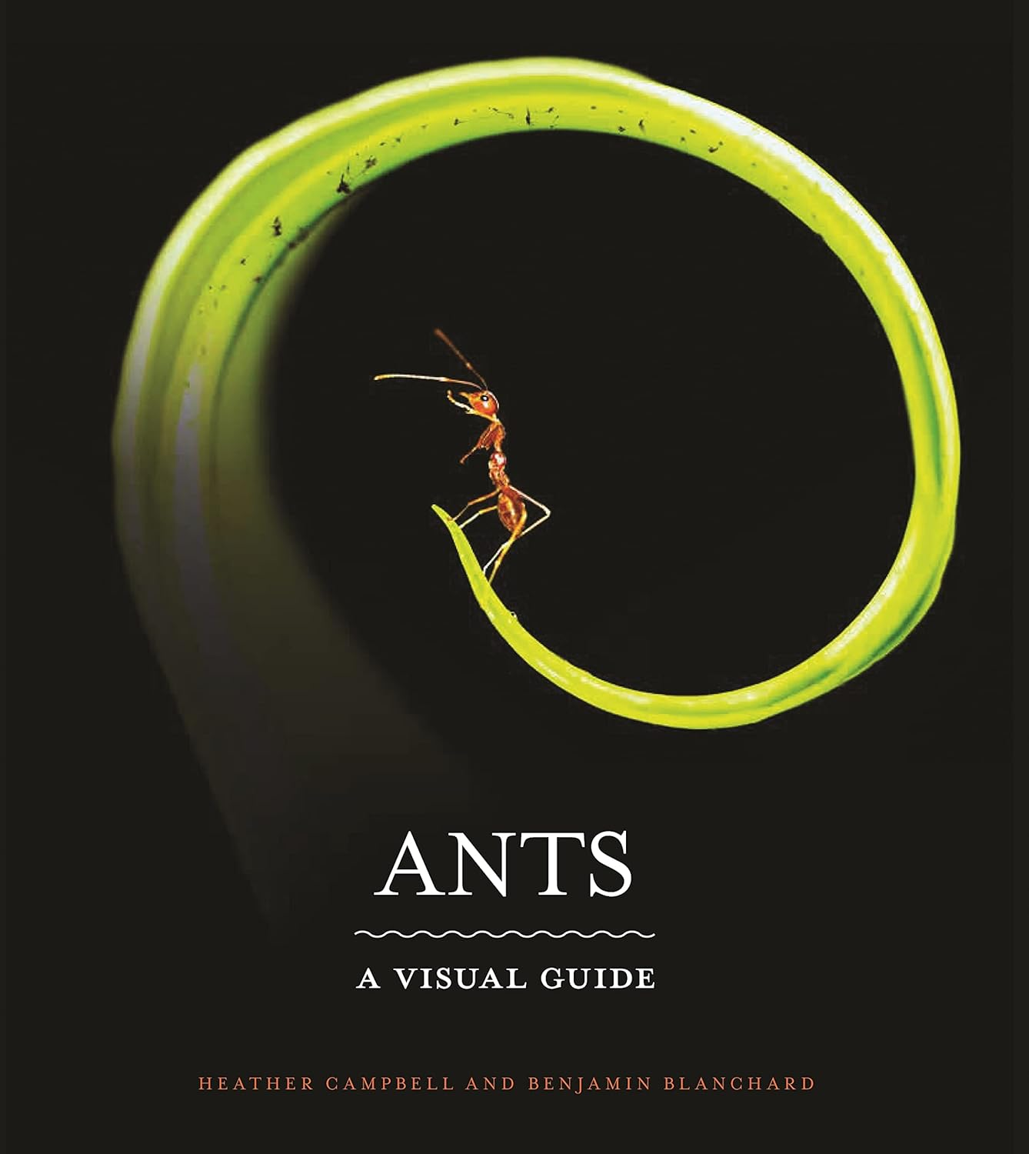

ANTS
A VISUAL GUIDE

